Slide 1

ACA Project
Matheus Fim (M. 876069)
Domenico Favaro (M. 837995)
Implementation of a subset of OpenCL wrapper for Mango API

Slide 2

Parallel Programming
1
The basis of parallel programming allows us to split a program in several processes to be executed in different cores simultaneously.
This is called Task level parallelism and it is implemented at a higher level of what could be ILP.
With the same objective: Increase performance

Slide 3

Mango API
2
Is a platform designed to exploit many-core architectures designed for High Performance Computing (HPC).
Apart from increasing Performance and Power efficiency it tries to provide a certain level of Predictability for applications to increase resources managing efficiency.

Slide 4

OpenCL - Wrapper
3
Open Computing Language is the most common API for parallel programming that allows us to use computing devices CPUs and GPUs.
Our Objective is to implement a wrapper around the Mango framework using OpenCL compliant calls, more widely used in parallel programming.

Slide 5

Mango Program Flow
4
To comprehend what elements we should wrap we’ll follow each step of common program flow that uses Mango framework.
Init: Creates the Mango Context that will hold the state of the host running the program.

Slide 6

Mango Program Flow
5
Kernel Declaration: We define which functions are executed by which kernels
Buffer Registration: Input and Output streams for the Kernels to use.

Slide 7

Mango Program Flow
6
Create TaskGraph: Data structure that represents a task that includes 1 or several kernels and events.
Resource Allocation: Mango efficiently manages the resources to allocate to the execution.

Slide 8
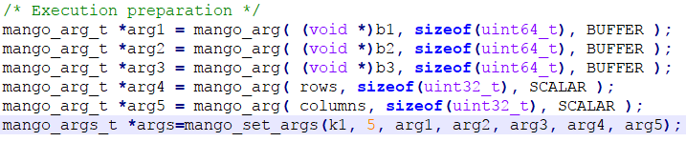
Mango Program Flow
7
Declare Arguments: to be passed to the kernel in this execution, can be scalars or pointers to buffers.

Slide 9


Mango Program Flow
8
Write Buffers: Transfer the data from the host to the device.
Start Kernels: Start Execution and wait (synchronization) for its completion.

Slide 10


Mango Program Flow
9
Read Buffer Results: from the finished execution from device to host.
Deallocate resources: Free all the resources used by the device.

Slide 11
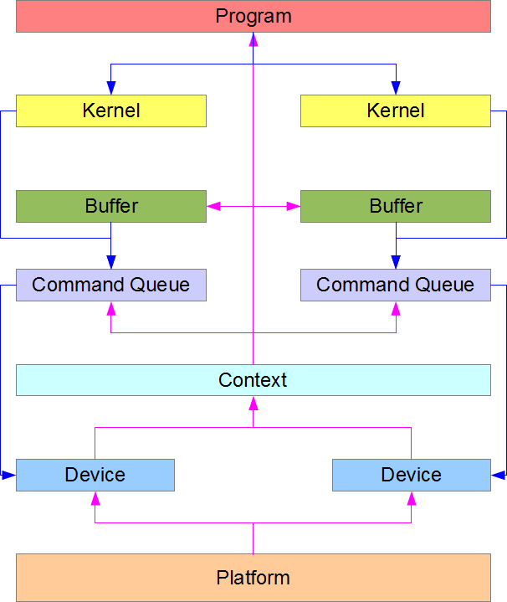
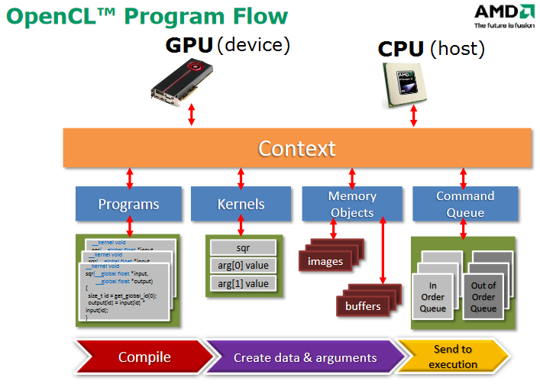
OpenCL Structure
10

Slide 12
OpenCL Flow - Wrapper
11
Platform and Devices: Mango does not handle platform or device management at this level. A simulation for get Platform and Device calls can be put in place to present the availability of a CPU device. Handling of GPUs will not be included.

Slide 13
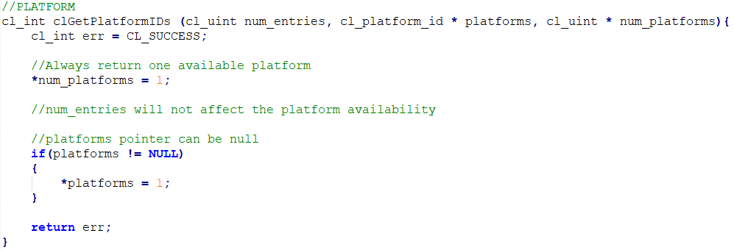
OpenCL Flow - Wrapper
12

Slide 14
OpenCL Flow - Wrapper
13
Create Context: the OpenCL call Create Context (assuming always a CPU context) will call the Mango Init function effectively creating the Mango Context .
Kernel Declaration: Create Program will translate to the Mango KernelFunction and create Kernel to Mango’s register Kernel

Slide 15
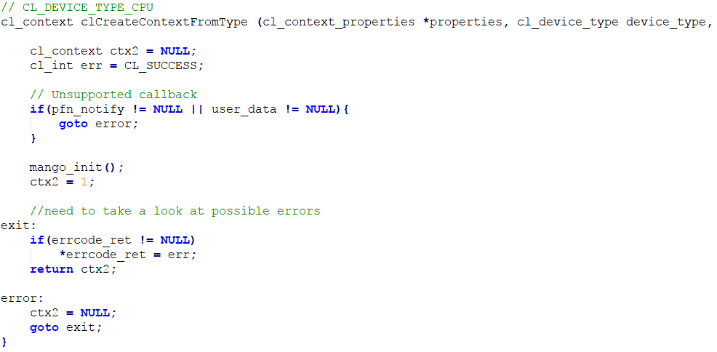
OpenCL Flow - Wrapper
14

Slide 16
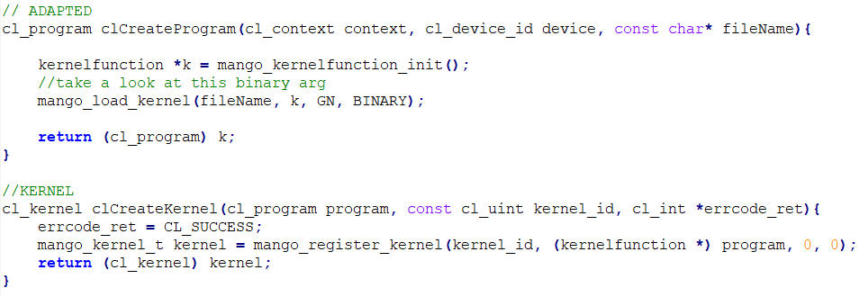
OpenCL Flow - Wrapper
15

Slide 17
OpenCL Flow - Wrapper
16
Buffer Registration: OpenCL Buffers, also cl_mem are created as Mango Buffers, functioning in the same way.
Create TaskGraph & Resource Allocation: The way OpecnCL and Mango setup their structures to execute the kernels differs in several ways. An adapted CommandQueue can be translated to a Mango TaskGraph but cannot support the same way as CommandQueues can enqueue more kernels at runtime.

Slide 18
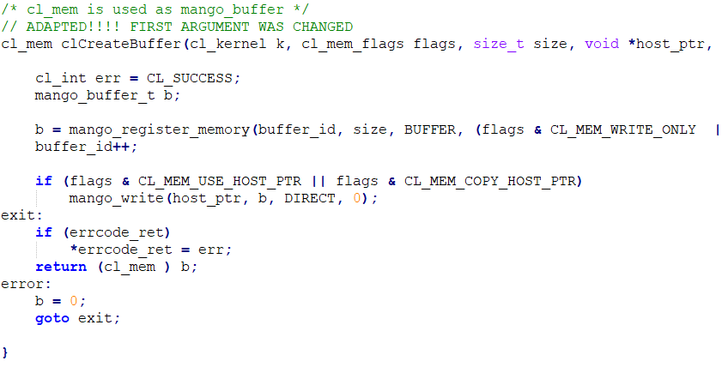
OpenCL Flow - Wrapper
17

Slide 19
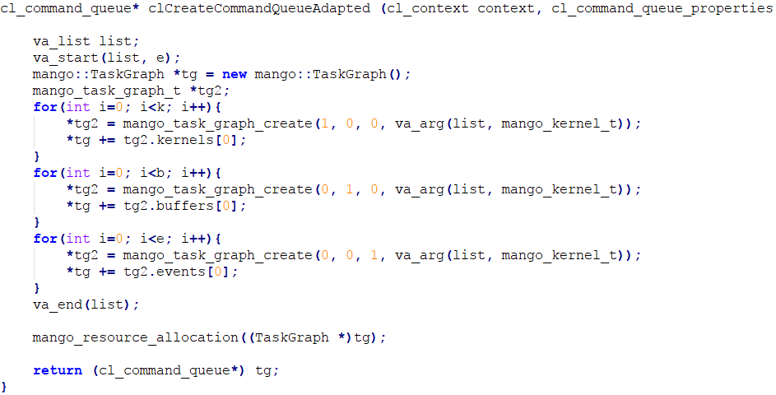
OpenCL Flow - Wrapper
18

Slide 20
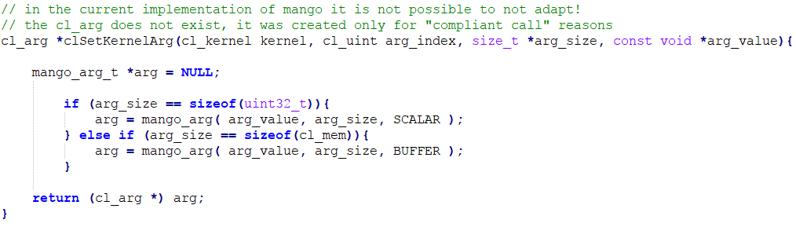
OpenCL Flow - Wrapper
19
Set Arguments: OpenCL sets kernel arguments directly into the Kernel while Mango has a mango_arg type that are then set at the same time to its kernel. Its implementation changes.

Slide 21
OpenCL Flow - Wrapper
20
Write Buffers: In OpenCL buffer writing can be enqueued in the command queues, and it can be set to wait for events if necessary. In mango it translates to a wait plus a write.
Read Buffers: Same thing can be said for reading Buffers translating the write into a read.

Slide 22
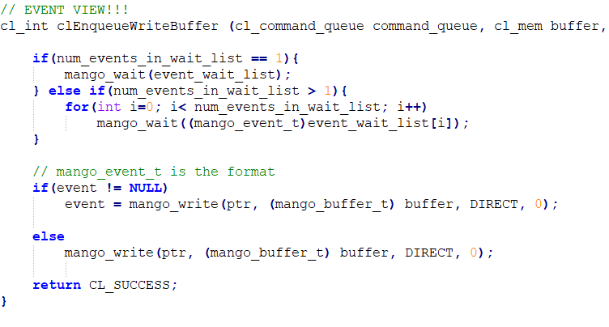
OpenCL Flow - Wrapper
21

Slide 23
OpenCL Flow - Wrapper
22
Start Kernel: Similar to buffer read/write, the kernel execution is enqueued in OpenCL and can bu subject to event synchronization, it can be done in a similar fashion with Mango start Kernel.

Slide 24
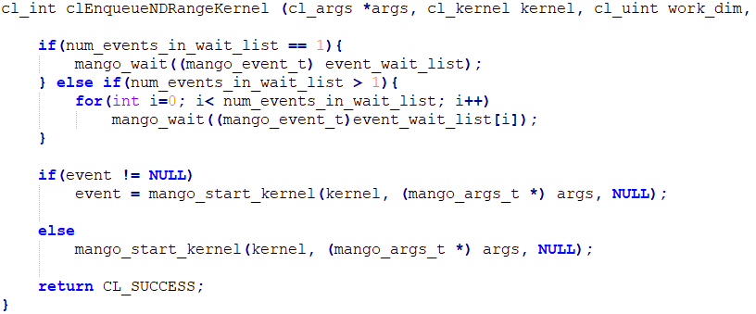
OpenCL Flow - Wrapper
23

Slide 25
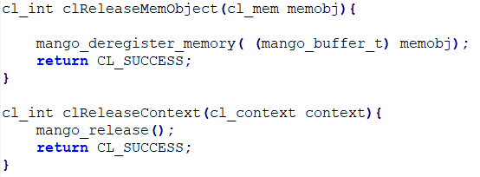
OpenCL Flow - Wrapper
24
Deallocate Resources: Mango resource deallocation can be used but also the release of individual buffers or kernels can be implemented.

Slide 26
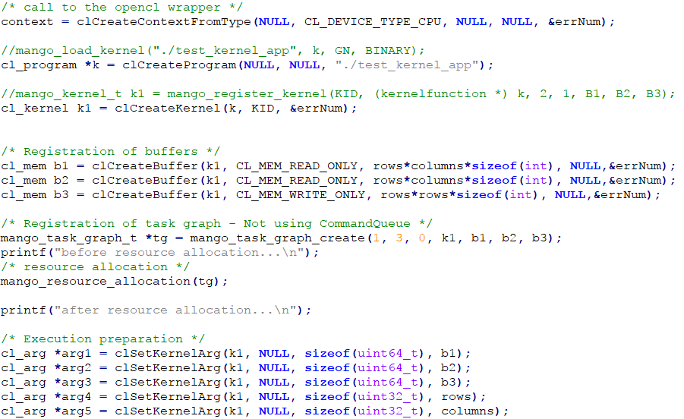
Example Code - Wrapper
25

Slide 27
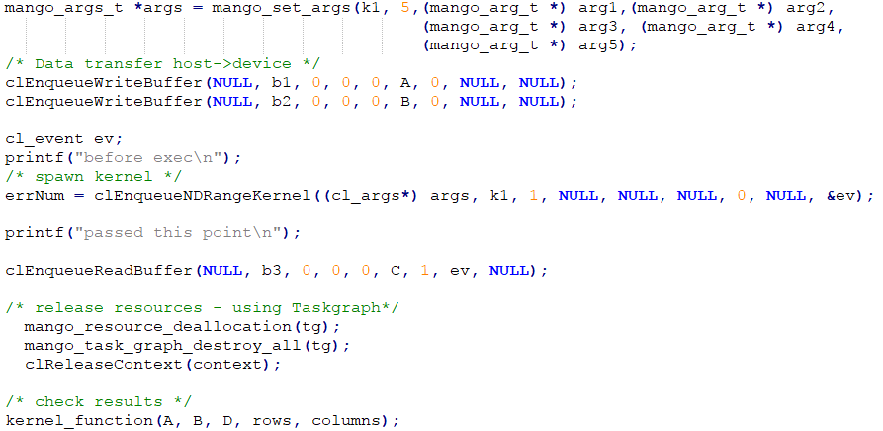
Example Code - Wrapper
26

Slide 28
References
27
Mango: http://www.mango-project.eu/
OpenCL: OpenCL Programming Guide - by Benedict Gaster and Timothy G. Mattson
Khronos OpenCL: https://www.khronos.org/opencl/

Slide 29
Questions
28
Thank you!

